Slide 1
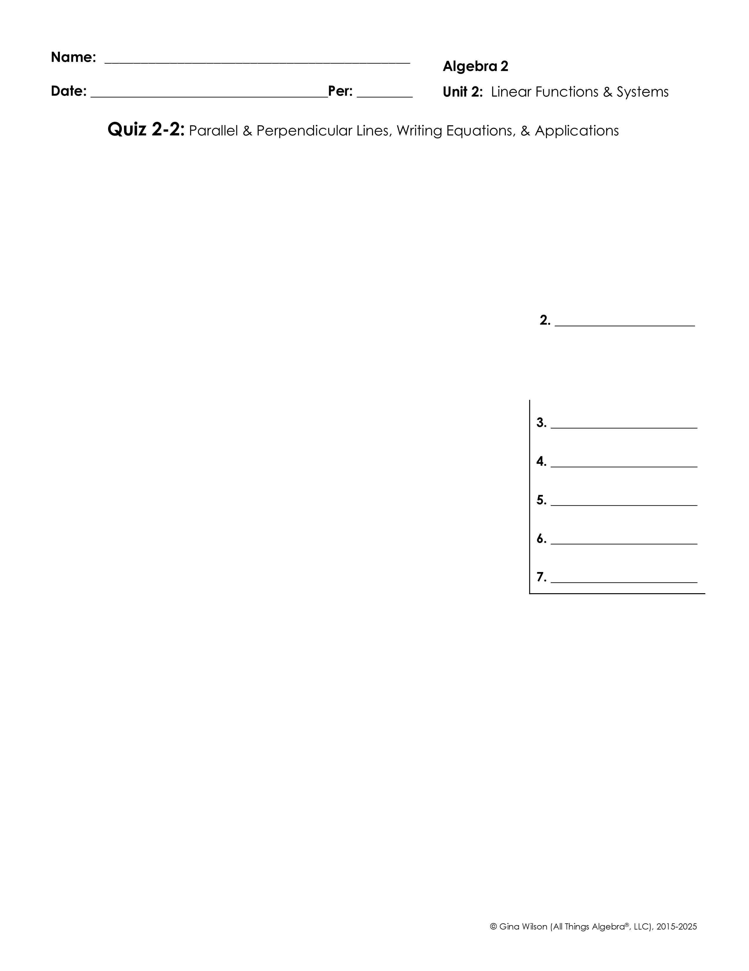

1. Which equations are parallel to the line -3x – 6y = 30? Check all that apply.
2. Give an example of a linear equation that is perpendicular to y = 5.
Write the equation of the line in slope-intercept form with the given information.
3. Passes through (-8, 7) with a slope of
4. Passes through (-2, -8) and parallel to 7x – 2y = -8.
5. Passes through (2, -2) and (-3, -17)
6. Passes through (5, 2) and perpendicular to 5x – 2y = -6.
7. Passes through (-8, -7) and perpendicular to the line passing through the points (-6, 3) and (-1, -7).

Slide 2
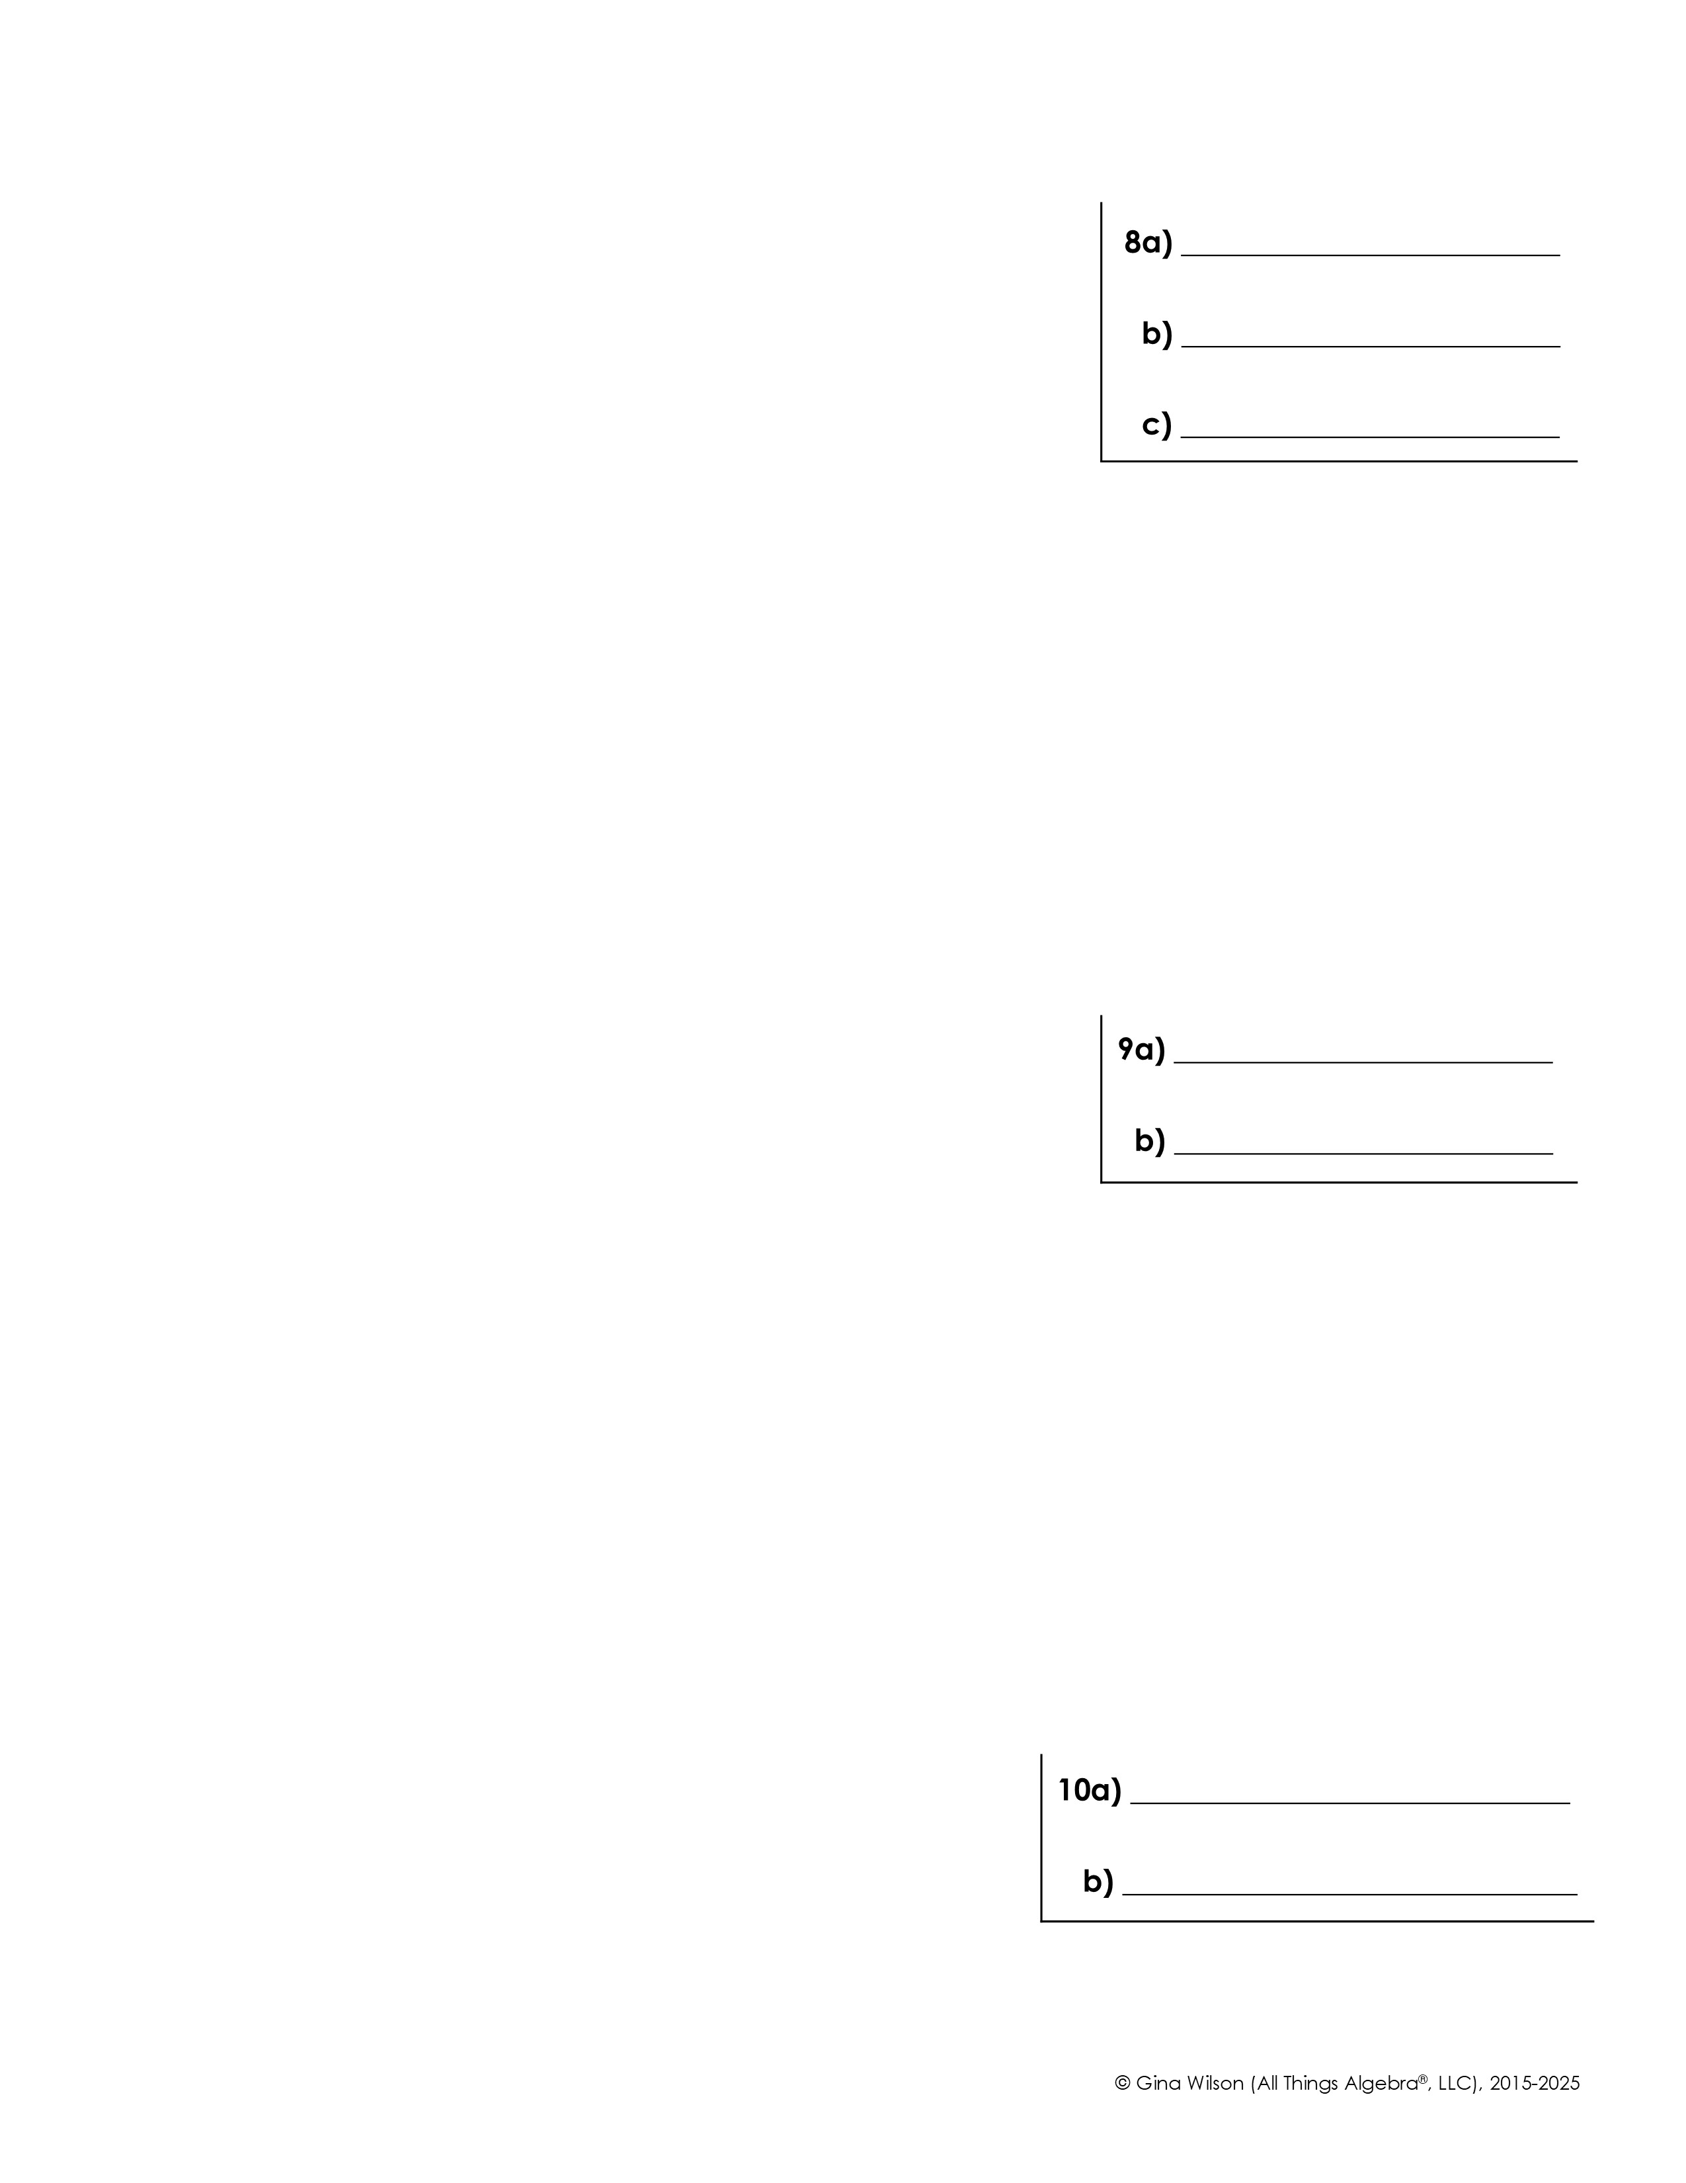
8. To manage a rental property, a property manager charges $59 per month plus 8% of the rent.
a) Write an equation to represent the total monthly fees charged by the property manager.
b) If Jack pays the property manager $165 each month, what is the monthly rent on his property?
c) If Jack raises the rent on the house to $1,495, how much more will he pay the property manager each month?
9. Katya tutors and works in the college bookstore to pay for her college tuition. She makes $20 per hour tutoring and $8.50 per hour working in the bookstore.
a) Write an equation to represent the total amount of money Katya earns tutoring and working in the bookstore.
b) The tuition for one semester (16 weeks) is $5,736. If Katya works 21 hours each week in the bookstore, how many hours per week must she tutor to pay her tuition?
10. The table below shows the average price of a personal computer during certain years.
year | 1997 | 1999 | 2003 | 2007 | 2010 | 2012
price | $1,950 | $1,719 | $1,420 | $1,175 | $949 | $725
a) Write an equation to model the data using linear regression.
b) Use the equation to predict the average cost of a personal computer in 2020.

